Slide 1
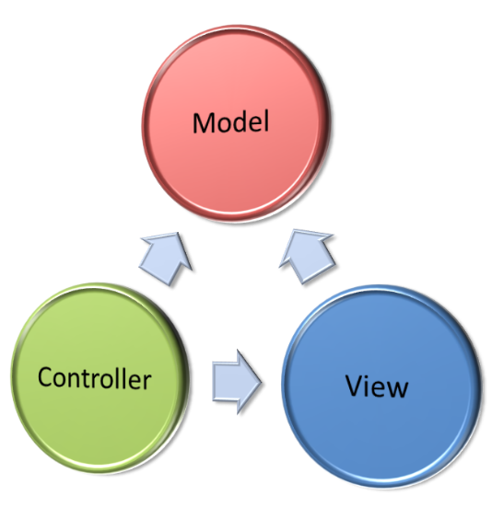
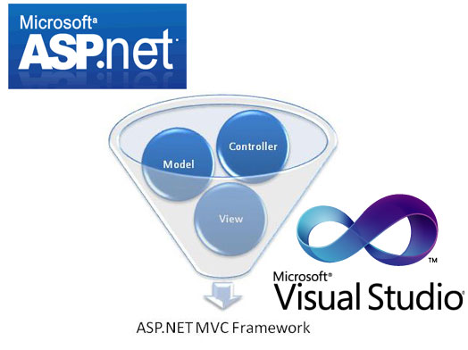
ASP.NET MVC
Course Program, Evaluation, Exams, Resources

Slide 2

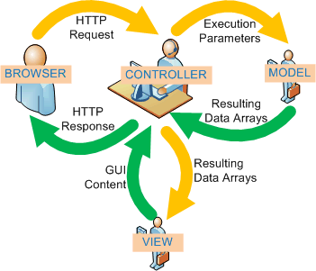
Table of Contents
Course Objectives
Course Program
Examination
Learning Resources

Slide 3

ASP.NET MVC
Course Objectives & Program

Slide 4

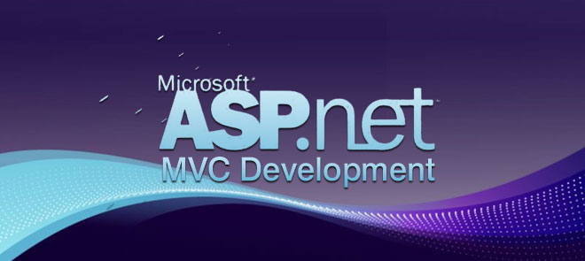
Course Program
Course Introduction
ASP.NET MVC Introduction
ASP.NET MVC Concepts (Part 1)
ASP.NET MVC Concepts (Part 2)
ASP.NET Identity
Working with Data
AJAX in ASP.NET MVC
SignalR

Slide 5
Course Program
ASP.NET Web Security
Caching Data
IIS Deployment
Advanced Topics
Exam Preparation
Visual Studio 2017 & ASP.NET MVC 6
Exam

Slide 6

The Practical Exam
ASP.NET MVC practical exam
Design and implement a Web application
Use ASP.NET MVC
Follow the principles of high-quality-code

Slide 7








Resources
What We Need Additionally?

Slide 8
Recommended Software
Microsoft Visual Studio 2017
Use the latest Visual Studio!
Microsoft SQL Server Express

Slide 9
ASP.NET MVC

